Slide 1

IBM data science capstone project - SpaceX
REYO ELIZABETH JOHN
01-08-2021

Slide 2


Outline
Executive Summary
Introduction
Methodology
Results
Conclusion
Appendix

Slide 3

EXECUTIVE SUMMARY
Summary of methodologies
Data collection
Data wrangling
EDA with data visualization
EDA with SQL
Building an interactive map with folium
Building a Dashboard with Plotly dash
Predictive analysis (Classification)
Summary of all results
Exploratory data analysis results
Interactive analytics
Predictive analysis

Slide 4
INTRODUCTION
Project background and context
We have predicted if the Falcon 9 stage 1 will land successfully.SpaceX advertises Falcon 9 rocket launches on its website with a cost of 62 million dollars; other providers cost upwards of 165 million dollars each, much of the savings is because SpaceX can reuse the first stage. Therefore, if we can determine if the first stage will land, we can determine the cost of a launch. Our job is to determine the price of each launch.
Problems we want to find answers
What influences if the rocket will land successfully?
The effect each relationship with certain rocket will ipmact in determining the success rate of a successful landing.
What conditions does SpaceX have to achieve to get the best results and ensure the best rocket scuccess landing rate.

Slide 5
METHODOLOGY

Slide 6
METHODOLOGY
Data collection methodology:
SpaceX Rest API
(Web Scrapping) from Wikipedia
Performed data wrangling(Transforming data for Machine learning)
One Hot Encoding data fields for Machine Learning and dropping irrelevant columns
Performed exploratory data analysis(EDA) using visualization and SQL
Plotting: Scatter Graphs, Bar Graphs to show relationships between variables to show patterns of data.
Performed interactive visual analytics using Folium and Plotly Dash
Performed predictive analysis using classification models
Models were build using scikit-learn, we used a GridSearch with 10 fold of cross validation, in the end we use the accuracy to determine the best classifier

Slide 7
DATA COLLECTION
The following datasets was collected:
We worked with SpaceX launch data that is gathered from the SpaceX REST API.
This API will give us data about launches, including information about the rocket used, payload delivered, launch specifications, landing specifications and landing outcome.
The SpaceX REST API endpoints , or URL, starts with api.spacexdata.com/v4/.
Another popular data source for obtaining Falcon 9 Launch data is web scrapping Wikipedia using BeautifulSoup.
Use SpaceX REST API
API returns SpaceX data in JSON
Normalize data into flat data file such as csv
Get HTML response from Wikipedia
Extract data using BeautifulSoup
Convert into Pandas Data
SpaceX API
Web Scrapping

Slide 8

Data Collection –SpaceX API
SpaceX
We collect the data from SaceX REST API , then filter and clean the data set for Falcon 9 and normalize the set .
GitHub URL
API
Filter data frame for Falcon 9
Clean data
Normalize the data into flat data file such as CSV

Slide 9

Data Collection –Web Scraping
We have used BeautifulSoup to web scrap HTML data from Wikipedia and parse the data into Pandas Dataframe
GitHub URL
HTML
Extract Data
BeautifulSoup
Parse data
Pandas data

Slide 10
Data Collection –Wrangling
We have used BeautifulSoup to web scrap HTML data from Wikipedia and parse the data into Pandas Dataframe.
Populate the table with rows collected.
GitHub URL
Raw Data
Pandas Data
Labels

Slide 11
EDA with Data Visualization
We used:
A scatter plot of FlightNumber vs. PayloadMass based on the outcome to see if as the flight number increases,
The first stage is more likely to land successfully and if there is an impact of PayloadMass
Then a second scatter plot of LaunchSite vs. FlightNumber based on the outcome to understand if the LaunchSite does not become a problematic element following the number of rockets which are launched there (FlightNumber).
A third scatter plot to observe if there is any relationship between LaunchSite and their PayloadMass
A bar chart to visually check if there are any relationship between the Success Rate and the Orbit Type
Another scatter plot to visualize the relationship between FlightNumber and Orbit type
A last scatter plot to reveal the relationship between Payload and Orbit type
And a line plot to get the average launch success trend
GitHub URL

Slide 12
EDA with SQL
SQL queries were performed as followed :
The names of the unique launch sites in the space mission
5 records where launch sites begin with the string 'CCA'
The total payload mass carried by boosters launched by NASA (CRS)
The average payload mass carried by booster version F9 v1.1
The date when the first successful landing outcome in ground pad was achieved
Names of the boosters which have success in drone ship and have payload mass greater than 4000 but less than 6000
Total number of successful and failure mission outcomes
Names of the booster_versions which have carried the maximum payload mass
Failed landing_outcomes in drone ship, their booster versions, and launch site names for in year 2015
The count of landing outcomes (such as Failure (drone ship) or Success (ground pad)) between the date 2010-06-04 and 2017-03-20, in descending order
GitHub URL

Slide 13
Build an Interactive Map with Folium
To visualize the Launch Data into an interactive map. We took latitude and longitude Coordinates at each launch site and added a Circle Marker around each launch site with a label of the name of the launch site.
We assigned the data frame launch_outcomes to classes 0 and 1 with Green and Red markers on the map in MarkerCluster().
Using Haversine's formula we calculated the distance from Launch site to various landmarks to find various trends about what is around the Lauch Site to measure patterns. Lines are drawn on the map to measure distance to landmarks.
GitHub URL

Slide 14
Build a Dashboard with Plotly Dash
Pie Chart showing the total launches by a certain site/all
Helps us to understand the success rate on each launching site
Scatter Graph showing the relationship with Outcome and Payload Mass(Kg) for the different Booster Versions
Demonstrates which booster as the higher rate and that it is related to the Payload mass
GitHub URL

Slide 15
Predictive analysis(Classification)
Building Model
Load our dataset into Numpy and Pandas
Transform Data
Split our data into training and test data sets
Check how many test samples we have
Decide which type of machine learning algorithms we want to use
Set our parameters and algorithms to GridSearchV
Fit our datasets into the GridsearchCV
Evaluating Model
Check accuracy for each model
Check accuracy of test data
Plot Confusion Matrix
Improving Model
Feature Engineering
Finding the best performing Classification Model
The model with the best accuracy score wins the best performing model
GitHub URL

Slide 16
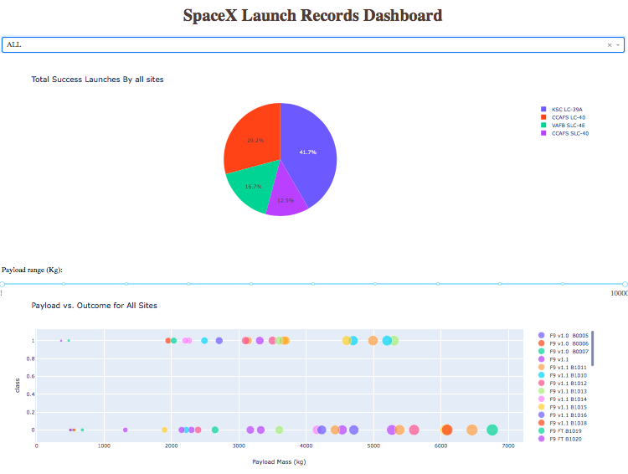
Results
The EDA demonstrate the importance of the payload mass and also the booster version on the success rate of the launch missions.
All machine learning models studied were equally performing.

Slide 17
Insights Drawn from EDA

Slide 18
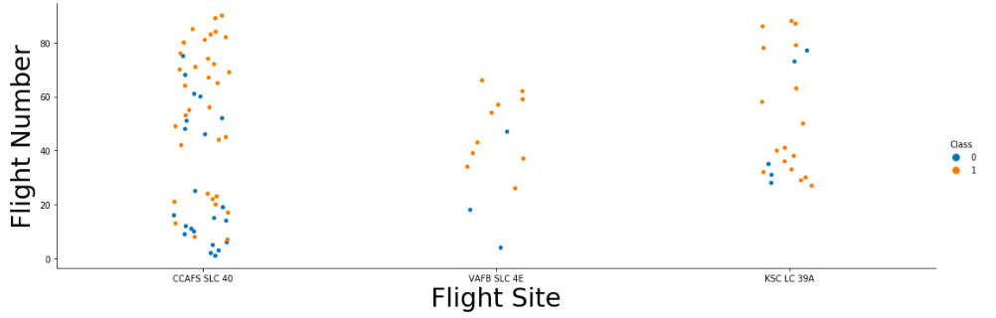
Flight number vs. Launch site
The success rate increases with the number of flights

Slide 19
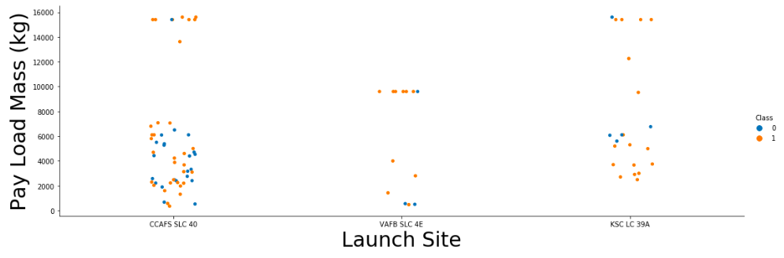
Payload mass vs. Launch site
The greater the payload mass for Launch Site CCAFS SLC 40 the higher the success rate for the Rocket. There is not quite a clear pattern to be found using this visualization to make a decision if the Launch Site is dependent on Pay Load Mass for a success launch.

Slide 20
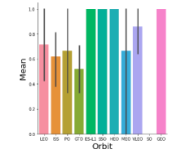
Success Rate vs. Orbit Type
Orbits ES-L1,SSO,HEO and GEO has the best success rate

Slide 21
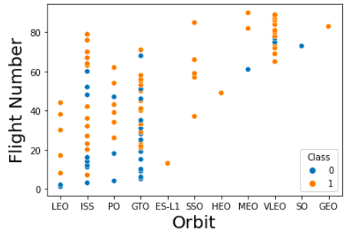
Flight Number vs. Orbit Type
We can see that in the LEO orbit the Success appears related to the number of flights; on the other hand, there seems to be no relationship between flight number when in GTO orbit.

Slide 22
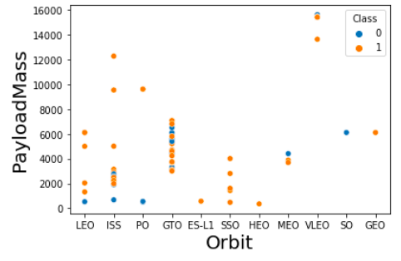
Payload mass vs. Orbit Type
Payload mass have a strong influence on some sites. For example, GTO orbits have a negative influence and for LEO orbits payload mass have positive influence.

Slide 23
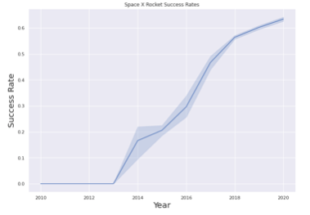
Launch Success Yearly Trend
The success rate increases since 2013

Slide 24
EDA with SQL

Slide 25
All Lauch Site Names
Launch sites are :
CCAFS LC-40
CCAFS SLC-40
CCAFSSLC-40
KSC LC-39A
VAFB SLC-4E
SQL Query:
Using the word DISTINCT in query to show the unique values in the Launch_site column

Slide 26
Launch Site Names Begin with 'CCA'
5 records where launch sites begin with `CCA` :
Date | Time (utc) | Booster version | Launch site | payload | Payload mass(KG) | orbit | customer | Mission outcome | Landing outcome
2010-06-04 | 18:45:00 | F9 v1.0 B0003 | CCAFS LC-40 | Dragon Spacecraft Qualification Unit | 0 | LEO | SpaceX | Success | Failure (parachute)
2010-12-08 | 15:43:00 | F9 v1.0 B0004 | CCAFS LC-40 | Dragon demo flight C1, two CubeSats, barrel of Brouere cheese | 0 | LEO (ISS) | NASA (COTS) NRO | Success | Failure (parachute)
2012-05-22 | 07:44:00 | F9 v1.0 B0005 | CCAFS LC-40 | Dragon demo flight C2 | 525 | LEO (ISS) | NASA (COTS) | Success | No attempt
2012-10-08 | 00:35:00 | F9 v1.0 B0006 | CCAFS LC-40 | SpaceX CRS-1 | 500 | LEO (ISS) | NASA (CRS) | Success | No attempt
2013-03-01 | 15:10:00 | F9 v1.0 B0007 | CCAFS LC-40 | SpaceX CRS-2 | 677 | LEO (ISS) | NASA (CRS) | Success | No attempt
SQL Query
Select all columns from SPACEXTBL where LAUNCH_SITE like 'CCA' and display limited to 5 rows.

Slide 27
Total Payload Mass
The total payload carried by boosters from NASA is 99980 KG.
SQL Query
Using the function SUM ,we get the total in the column PAYLOAD_MASS__KG_
The WHERE clause filters the dataset to only perform calculation on Customer NASA

Slide 28
Average Payload Mass by F9 v1.1
The average payload mass carried by booster version F9 v1.1 is:
2534 KG
SQL Query
Using the function AVG ,we get the average in the column PAYLOAD_MASS__KG_
The WHERE clause filters the dataset to only perform calculation on Booster version F9 v1.1

Slide 29
First Successful Ground Landing Date
The date of the first successful landing outcome on ground pad was
achieved in 2015-12-22
SQL Query
Using the function MIN, we get the minimum date in the column DATE
The WHERE clause filters the dataset to only perform calculation on Success (ground pad)

Slide 30
Successful Drone Ship Landing with Payload between 4000 and 6000
The names of the boosters which have success in drone ship and have payload mass greater than 4000 but less than 6000 are:
F9 FT B1032.1
F9 B4 B1040.1
F9 B4 B1043.1
SQL Query
SELECT only the BOOSTER_VERSION column
The WHERE clause filters the dataset to LANDING__OUTCOME like 'Success (ground pad)' and PAYLOAD_MASS__KG_ between 4000 and 6000

Slide 31
Total Number of Successful and Failure Mission Outcomes
The total number of successful and failure mission outcomes :
SQL Query
SELECT only the BOOSTER_VERSION column
The WHERE clause filters the dataset to LANDING__OUTCOME like 'Success (ground pad)' and PAYLOAD_MASS__KG_ between 4000 and 6000
Mission Outcome | Success or Failure
Failure (in flight) | 1
Success | 99
Success (payload status unclear) | 1

Slide 32
2015 Launch Records
List of the failed landing_outcomes in drone ship, their booster versions, and launch site names for in year 2015
SQL Query
Select only LANDING__OUTCOME,BOOSTER_VERSION and LAUNCH_SITE
The WHERE clause filters the dataset to DATE like '%2015%' and LANDING__OUTCOME like '%Failure'
Landing Outcome | Booster version | Launch site
Failure (drone ship) | F9 v1.1 B1012 | CCAFS LC-40
Failure (drone ship) | F9 v1.1 B1015 | CCAFS LC-40

Slide 33
Rank Landing Outcomes Between 2010-06-04 and 2017-03-20
Rank the count of landing outcomes (such as Failure (drone ship) or Success (ground pad)) between the date 2010-06-04 and 2017-03-20, in descending order
SQL Query
Select the distinct LANDING__OUTCOME and count it.
The WHERE clause filters the dataset to DATE between '2010-06-04' and '2017-03-20' and groupby LANDING__OUTCOME in descending order using ORDER BY.
Landing Outcome | No attempt | Failure(drone ship) | Success(drone ship) | Controlled(ocean) | Success(ground pad) | Failure(parachute) | Uncontrolled(ocean) | Precluded(drone ship)
Count | 10 | 5 | 5 | 3 | 3 |  | 2 | 1

Slide 34
Launch Sites Proximities Analysis

Slide 35
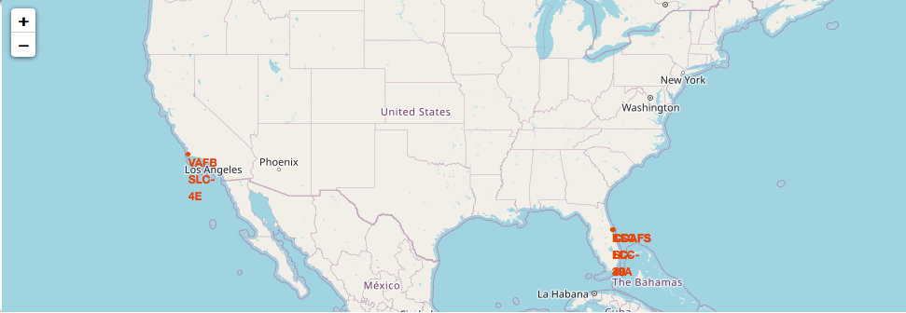
Launch sites in the US
We can see that the SpaceX launch sites are in the United States of Ameica's coasts, Florida and California

Slide 36
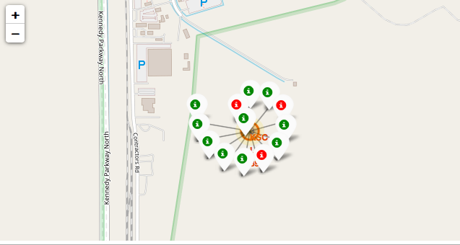
Success or Failure Marker
Green Marker shows successful Launches and Red Marker shows failures

Slide 37
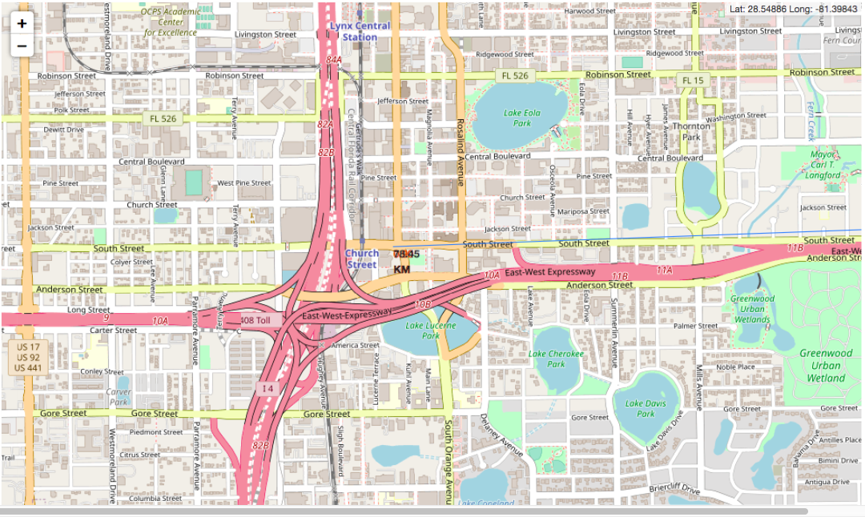
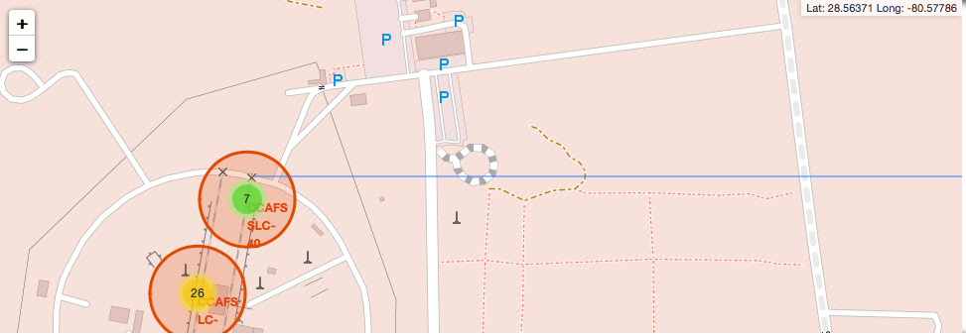
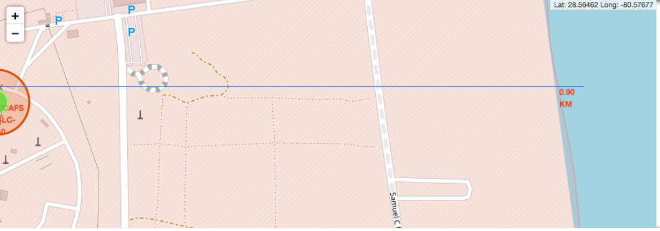
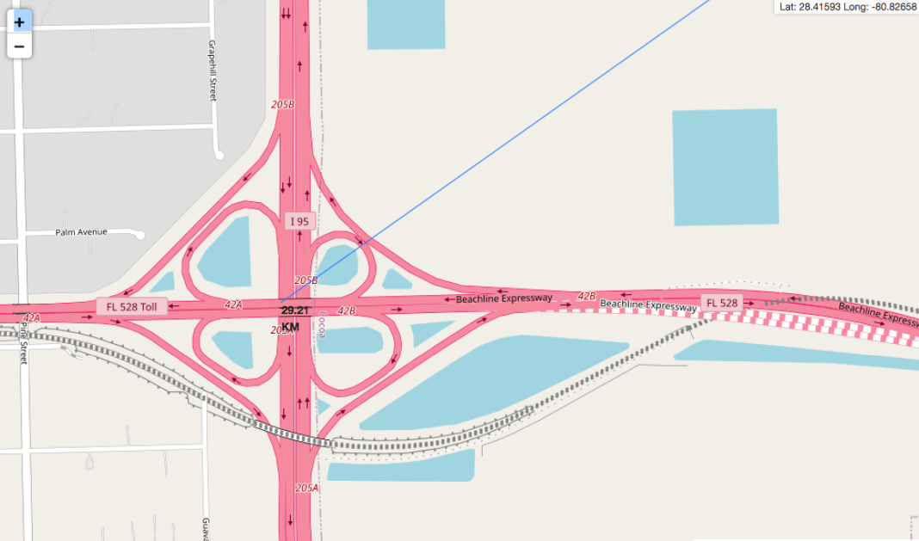
Launch sites proximities
We can see the proximity of the launching site and the railway station and proximities with the coastline,city and closest Highway
Distance to railway station
Distance to nearest city
Distance to coastline
Distance to nearest highway

Slide 38
Building a Dashboard with Plotly Dash

Slide 39
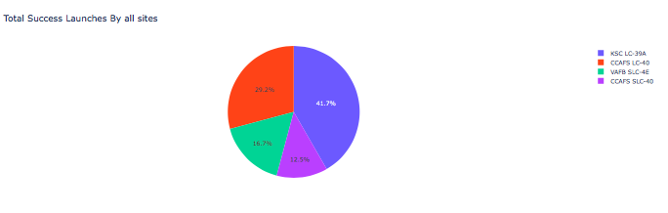
Success rate of all sites
We can see that KSC LC –39A has the most successful launches among all the sites.

Slide 40
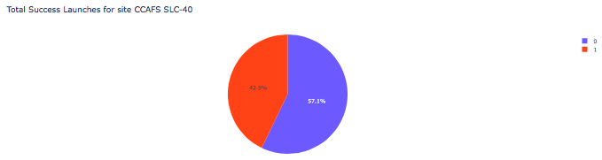
Success rate of CCAFA SLC-40 best ratio
We can see that CCAFA SLC-40
has 42.9% successful launches

Slide 41
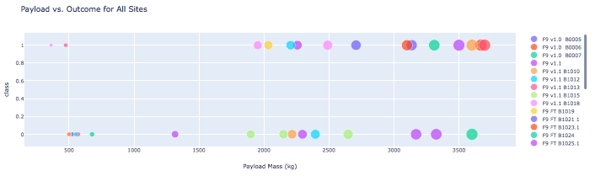
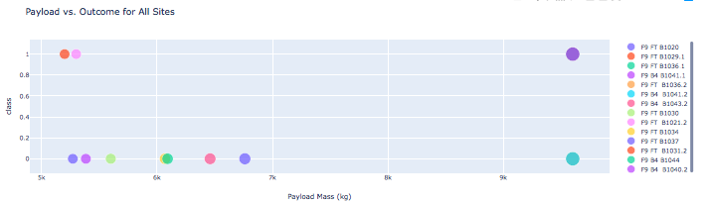
Payload vs. Launch Outcome scatter plot for all sites
It is clear from the scatter plots that success rate is high for low weighted pay loads than heavy payloads

Slide 42
Predictive Analysis (Classification)

Slide 43
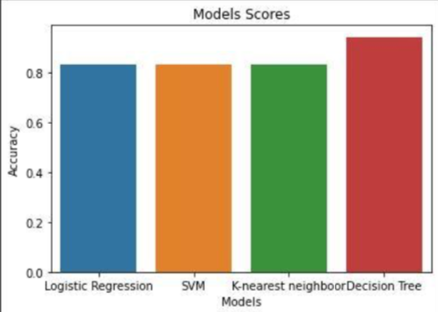
Classification Accuracy
The best model based on accuracy is a Decision Tree Classifier with a score of 0.9166

Slide 44
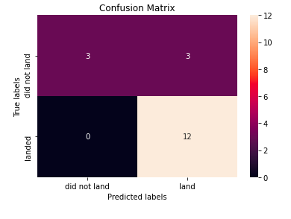
Confusion Matrix
This summarizes the performance of classification algorithm. Examining the confusion matrix, we can distinguish between different classes. We see that the major problem is false positive.
Predicted Values
Negative
Positive
TN 3 | FP 3
FN 0 | TP 12
Negative
Actual Values
Positive

Slide 45
Conclusion
All algorithms performs equally, since the data set is small.
Payloads with low weight performs better than that with heavy weights.
The success rate increses each year since 2013 .
KSC LC –39A has the most successful launches from all the sites.
Orbit ES-L1,SSO,HEO and GEO have more success rate than others

Slide 46
Appendix
Haversine formula

Slide 47
Haversine formula
Haversine formula is used to calculate the distance between two GPS coordinates with Python
Formula:
a=sin(Δϕ )+cos(ϕ1 )⋅cos(ϕ2 )⋅sin(Δλ )
With:
c=2⋅arctan2( a , 1−a )
and
d=R .c
Where:
ϕ = latitude λ = longitude R = 6371 (Earth's mean radius in km)
2
2
2
2

Slide 48
Thank You!

